Slide 1
Sales Cloud Administration: Products, Quotes, Orders, and Collaborative Forecasts (Enterprise, Performance, and Unlimited Editions)
Notes:
Enterprise, Performance, and Unlimited Editions – Summer’16
Revised May 2016
This deck should be used with the following printed manuals (check code on cover):
Student Guide: SFADM-251V7-SG
Exercise Guide: SFADM-251V7-EG
Characters:
Allison Wheeler VP Global Sales, AW Computing
Kathy Cooper US Sales Director, AW Computing
Anna Bressan US Sales Rep, AW Computing
Frank Roberts US Sales Rep, AW Computing
Matt Wilson US Sales Rep, AW Computing
Jessica Heinz EMEA Sales Director, AW Computing
An Lin, APAC Sales Director, AW Computing
Jin Chang APAC Sales Rep, AW Computing
Karen Adams EMEA Sales Rep, AW Computing

Slide 2
Copyright

Slide 3
Safe Harbor Statement

Slide 4
Introductions
Notes:
This is for V/ILT and ILT only.

Slide 5
1-1: Log In and Update Your Profile
Your turn:
Goal:
Log in and update your Chatter profile.
5 minutes
Tasks:
Log in to the AW Computing organization:
URL: login.salesforce.com
Username: admin@aw####.com
Password: password1
Update your Chatter profile with your name and email.

Slide 6
Course Agenda
Set Up Products, Price Books, Quotes, and Orders
Set Up Collaborative Forecasts

Slide 7
Module 1: Set up Products, Price Books, Quotes, and Orders

Slide 8
Group Discussion
How does your organization currently track products and manage pricing on sales deals?
How does your organization currently manage orders?
What are the pain points in your current quoting, product, and order management processes?
Notes:
Teaching Points:
These questions were given as pre-work when they signed up for the course. If the students did not fill out the pre-work, they can just answer them during class.
The goal of these questions is to get students thinking about how their sales organization currently tracks products and their prices, creates quotes, and manages orders.
Extra Materials:
Here are some common answers that you might get from students:
1) Salesforce; Salesforce plus an external ERP system; ecommerce system; ?
2) AppExchange product, an external ERP system like SAP; several integrated systems; ?
3) Difficulty getting tools to be granular & flexible; complex integrations; multicurrency issues; supply chain or resourcing problems; tracking; complex product bundles
Suggestions:
Have the students pair up or create small groups to discuss their answers. When you reconvene, ask each pair of students to answer one of the questions OR
Call on different students to answer these questions about their own organizations.
Ask "For those of you who did not respond, it is because you are not using Salesforce for products and you want to learn how?" Please raise your hand if this is true.
Virtual Delivery:
Use break out rooms to allow students to discuss these questions in smaller groups OR
Ask these questions one at a time. For each question, have them chat their answers.
Highlight the common themes across different answers.

Slide 9

Manage Products, Prices, Quotes, and Orders
Allison Wheeler
VP Global Sales
“As part of our sales process, we want to track the quantity and prices of the products we sell. We also need to be able to generate quotes and track orders from customers.”
To accomplish this, you need to be able to:
Describe the capabilities of products, price books, quotes, and orders.
Describe the relationships between opportunities, products, price books, quotes, contracts, and orders.
Create and customize products and price books.
Add products to opportunities.
Create and edit quotes.
Add products to orders.
Notes:
Extra Materials:
Allison Wheeler is a VP of Global Sales. Her team uses Salesforce to manage the entire sales process from lead generation and qualification to moving deals though the sales pipeline and winning the deal.
Allison and other executives/managers want to be able to track which products are being sold, at what prices, quoting activity, and order activities.
Sales reps want an efficient way to add products to opportunities, provide quotes to their customers, and create orders.
Salesforce administrators and Sales operations managers want to be able to manage access to price books and maintain data quality.

Slide 10
Module Agenda
Creating and Customizing Products
Creating and Customizing Custom Price Books
Adding Products to Opportunities
Controlling Access to Products and Price Books
Creating Quotes
Creating Orders
Integrating Salesforce with Other Systems

Slide 11
Products and Price Books
Price Book: The list of products and their associated prices.
Price Book
Name | Code | Price
Product A | PAX2 | $10
Product B | PBX3 | $29
Product C | PCX4 | $30
Product D | PDX5 | $10
Product E | PEX6 | $200
Product F | PF7 | $25
Product G | PG8 | $400
Product H | PH9 | $40
Products: The individual items or services you sell.
Price book entry: A product and its price.
Notes:
Teaching Points:
Together, products and price books track the products and services your company offers, and the various prices at which they are sold.
A price book is a list of products and their associated prices. Each product and its price is called a price book entry.
The standard price book contains a related list of all standard price book entries.
Once they have been sold, products become assets. Assets represent products your customers have purchased. Assets can be used to track purchases from your orders or from another company.
Suggestions:
You can talk about the Price Book as a menu, which shows the products available to be ordered with their prices.

Slide 12
Product Families
Price Book
Products can be categorized into product families.
Product families help you organize products by type and analyze product sales.
Name | Code | Price | Product Family
Product A | PAX2 | $10 | Laptop
Product B | PBX3 | $29 | Laptop
Product C | PCX4 | $30 | Laptop
Product D | PDX5 | $10 | Desktop
Product E | PEX6 | $200 | Desktop
Product F | PF7 | $25 | Desktop
Product G | PG8 | $400 | Desktop
Product H | PH9 | $40 | Printer
Notes:
Teaching Points:
One way to manage products in the system is to organize them in categories called Product Families. This will be important if you want to forecast on products.
This is set in the Product Family picklist field, a standard field on the product object.

Slide 13
1-2: Add a Service Package Product
Watch me:
Goal:
Add a service package product and set the price.
5 minutes
Tasks:
Add Service Packages to the Product Family picklist.
Add an AW CompuCare product.
Set the standard price for each currency.
View the standard price book to see the AW CompuCare entries.
Currency | Standard Price
USD | 450
GBP | 275
EUR | 350
JPY | 450,000
SGD | 575
Notes:
Teaching Points:
Suggestions:
Students can follow along (like a Join Me) if they choose.
This exercise is NOT a dependency for other exercises.

Slide 14
How do Products and Price Books Relate to Each Other?
Use Schema Builder to determine how these objects relate to each other.
Product
Price Book
Price Book Entry
Setup | Schema Builder
CLICK PATH:
Notes:
Teaching Points:
*This slide has an animation.*
You can begin this slide with a discussion “Based on what we just saw in Salesforce, how would you describe the relationships between these objects?
These are lookup relationships – which object is the parent and which is the child?
In which direction would you draw the one-to-many relationships ?
Open Schema Builder to demonstrate for students. Clear all objects, then select Product, Price Book and Price Book Entry.
Product to price book entry = one to many: a single product can be given different prices for different price books.
Price book to price book entry = one to many: a price book contains many price book entries.
The Price Book Entry object creates the link between the product and the price book object (a product becomes part of a price book when it has been associated with a price).
Suggestions:
The student guide shows this diagram with no lines filled in between the objects – students can draw in the relationships in their printed student guide or on a piece of paper.
Students may not be familiar with Master-Detail relationships. You can focus on the parent/child and one to many aspects of these relationships.
Note: This slide has an animation to appear the connecting lines.

Slide 15
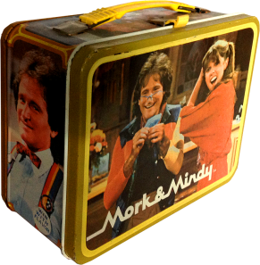

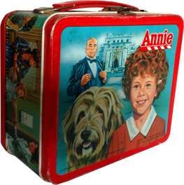
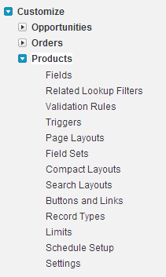
Customizing Products
Link to product image files.
Track product attributes to help users find and sort products.
Size XL
Storage 5MB
Store the product’s internal price (cost) to easily calculate margins.
Product Cost USD 900.00
Setup | Customize | Products
CLICK PATH:
Notes:
Teaching Points:
Custom fields can be used to help sort and organize products and store key information. This slide shows examples of using custom fields on products.
Like other objects, you can also:
Customize product page layouts
Define record types for products
Customize layout of fields on search results and lookup dialogs
Create validation rules

Slide 16
1-3: Add a Printer Product
Your turn:
Goal:
Add a WiFi-enabled printer product and set the price.
10 minutes
Tasks:
Add Printers to the Product Family picklist.
Create a WiFi checkbox on the Product object.
Add a Cyclone printer product that has WiFi enabled.
Set the standard price for each currency.
Edit the All Products list view to include the WiFi field.
Edit all laptop products to enable the WiFi checkbox.
Currency | Standard Price
USD | 2500
GBP | 1450
EUR | 1900
JPY | 250,000
SGD | 3200

Slide 17
Module Agenda
Creating and Customizing Products
Creating and Customizing Custom Price Books
Adding Products to Opportunities
Controlling Access to Products and Price Books
Creating Quotes
Creating Orders
Integrating Salesforce with Other Systems

Slide 18
Standard & Custom Price Books
Custom Price Book 1
Standard Price Book
Product A | $12.00
Product B | $20.00
Product C | $30.00
Product D | $12.00
Name | $
Product A | $10
Product B | $20
Product C | $30
Product D | $10
Product E | $20
Product F | $25
Product G | $40
Product H | $40
Subset of products at custom list prices
ALL products at their standard prices
Custom Price Book 2
Subset of products at custom list prices
Product D | $15.99
Product E | $25.99
Product F | $35.99
Product G | $45.99
Notes:
Teaching Points:
There are two types of price books in Salesforce—standard and custom.
The standard price book is a master list of all products with their associated default or standard prices. As we saw when we added products, it automatically lists all products and their standard prices.
A custom price book is a list of products with their custom (or list) prices.
Custom price books let you offer different prices to different market segments. Custom price books can contain list prices that are lower or higher than the standard price.
You may also use custom price books to separate the products that are offered in different markets/regions, or to list products at special prices for certain audiences or certain periods of time.
Users cannot combine entries from two different price books on an opportunity, so custom price books should be complete lists of the products that might be sold together.
Suggestions:
Ask “Why might you want different price books? What problems could this solve?”
Possible answers: price books for direct sales vs resale, online (web) price book, regions.
When showing Price Books in the org, you can point out that not all organizations have the Price Book tab visible. You can also get to the Price Books page by clicking the Manage Price Books link at the bottom of the Products page.

Slide 19
Working with Multiple Currencies
Price Book
A price book can contain prices for a product in many different currencies.
Name | $ | € | £
Product A | $10 | €10 | £10
Product B | $20 | €20 | £20
Product C | $30 | €30 | £30
Product D | $10 | €10 | £10
Product E | $20 | €20 | £20
Product F | $25 | €25 | £25
Product G | $40 | €40 | £40
Product H | $40 | €40 | £40
Notes:
Teaching Points:
If your organization uses multiple currencies, you can add entries for all currencies available to a product.
These can be created in both the Standard price book and any custom price books where they would be used.
When users add a product to an opportunity, only products with the currency that matches the opportunity currency will display.
Once a product record has been added to an opportunity the default currency can no longer be modified, as the product record was created using the existing default currency. Any Product records must be removed before the opportunity currency can be modified.

Slide 20
1-4: Add a Nonprofit Custom Price Book
Watch me:
Goal:
Add a custom price book for nonprofit customers in the US and the UK.
5 minutes
Tasks:
Create a custom price book called Nonprofit.
Add products at the nonprofit list prices.
Product Name | List Price
Bolt | USD 1260
Bolt | GBP 765
Bolt S | USD 1440
Lightning 2 | USD 1600
Lightning 2 | GBP 1000

Slide 21
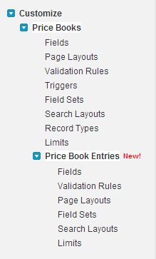
Customizing Price Books and Price Book Entries
Create a custom picklist to define market segment.
Create page layouts for specific product teams.
Use validation rules to prevent users from saving incorrect data.
Setup | Customize | Price Books
CLICK PATH:
Notes:
Teaching Points:
The price book and price book entry object can be customized like other objects by:
Adding custom fields
Setting up record types
Setting up validation rules
Customizing layouts
Let’s go add a custom field to price books to see how this might be useful.

Slide 22
1-5: Add an Enterprise Custom Price Book
Your turn:
Goal:
Track market regions on price books and add a custom price book for enterprise customers in APAC.
10 minutes
Tasks:
Create a picklist on the Price Book object to track the region: AMER, APAC, EMEA.
Create a custom price book called Enterprise – APAC, and set the region to APAC.
Add products at the enterprise list prices.
Product Name | List Price
Lightning 2 | SGD 1900
Lightning 2 | JPY 145,000
Lightning 5 | SGD 2400
Lightning 5 | JPY 195,000

Slide 23

Using Schedules on Products
Schedules can be set on products to define payment and delivery cycles.
Quantity:
Customers pay all at once, but receive the product in increments.
Revenue:
Customers make payments over time, but receive the product all at once.
Quantity + Revenue:
Customers make payments over time and receive products incrementally.
Magazine subscriptions billed annually but delivered monthly.
Payments on a car or a custom product purchase.
Wine of the month club.
Customize | Products | Schedule Setup
CLICK PATH:
Notes:
Teaching Points:
Now that you’ve set prices for products, you may want to set up scheduled payments. Schedules determine the payment and delivery cycles for a product.
Once schedules are enabled, they show up as a related list on the product record.
The default schedule set on a product will be applied when the product is added to an opportunity or quote. Users can refine the schedules as necessary on that opportunity or quote.
Suggestions:
You can demo this if there is time and interest.

Slide 24
Module Agenda
Creating and Customizing Products
Creating and Customizing Custom Price Books
Adding Products to Opportunities
Controlling Access to Products and Price Books
Creating Quotes
Creating Orders
Integrating Salesforce with Other Systems

Slide 25

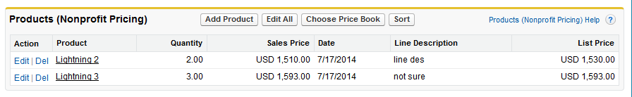
Adding Products to Opportunities
When products are added to an opportunity, they become Opportunity Products.
First, choose Price Book
From an Opportunity:
Then, add Products
Opportunity Products
An opportunity can be associated with many products, but they must come from the same price book.
NOTE:
Notes:
Teaching Points:
Products added to an opportunity must come from a single price book. The price book entry options available to select will match the currency set on the opportunity.
Once product line items are added to an opportunity, you can no longer manually control the amount of the opportunity. The sum of the Opportunity Products auto-populates the Opportunity Amount field.
An administrator, you can customize Salesforce to:
Prompt users to select a product when they create an opportunity (Setup | Customize | Opportunity | Settings)
Force users to add products when an opportunity is created using a validation rule.
Extra materials:
Sometimes Opportunity Products are referred to as Opportunity Line Items or Product Line items – they refer to the same object.

Slide 26
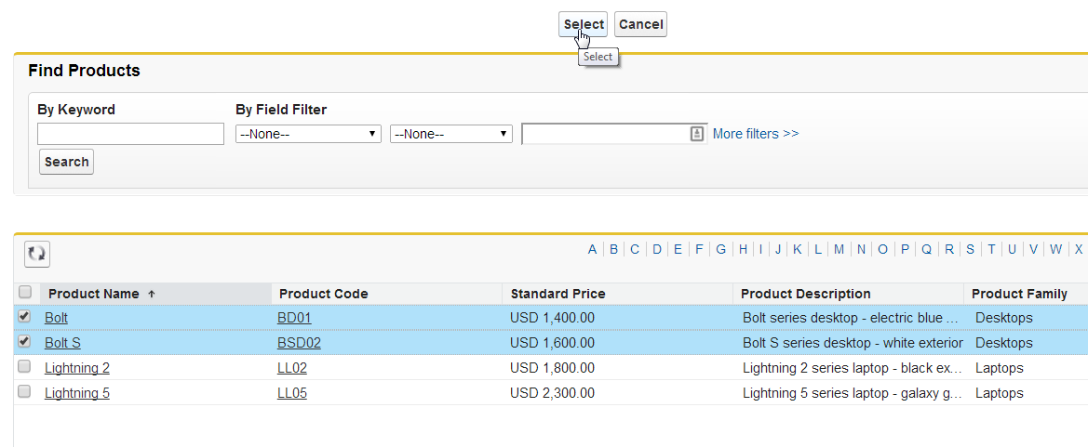
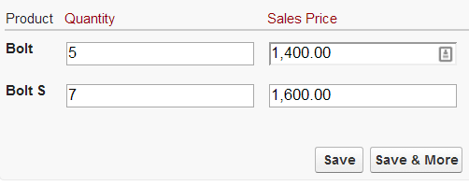
Selecting Products to Add to an Opportunity
After you have selected a price book, choose the products to add to the opportunity.
Use keywords and filters to narrow the list of products to choose from.
1
You will only see products whose currency matches the currency of the opportunity.
2
Select products to add.
3
Set product quantity on the next screen.
4
Notes:
Teaching Points:
The opportunity currency determines the currency of the products listed – users will not see products listed in other currencies.
You can use filters and keywords to narrow the list of products, then select the products.
On the next screen you’ll have the opportunity to set quantities and adjust sales prices.

Slide 27
How Do Opportunities Relate to Products and Price Books?
Use Schema Builder to determine how these objects relate to each other.
Opportunity
Product
Price Book
Opportunity
Product
Price Book Entry
Setup | Schema Builder
CLICK PATH:
Notes:
Teaching Points:
*This slide has an animation.*
Have students go their orgs. Open Schema Builder in a new tab (to keep open for upcoming exercises.)
Clear all objects, then select Opportunity , Opportunity Product, Product, Price Book, and Price Book Entry.
These are lookup relationships – which object is the parent and which is the child?
In which direction would you draw the one-to-many relationships?
Suggestions:
The student guide shows this diagram with no lines filled in between the objects – students can draw in the relationships in their printed student guide.
Note:
This slide has an animation to appear the connecting lines.

Slide 28
1-6: Add Products to a Nonprofit Opportunity
Watch me:
Goal:
Add products to an opportunity for a nonprofit account.
5 minutes
Tasks:
Add products to the Environmental Control Agency - Desktops opportunity using the Nonprofit price book.
Product | Quantity
Bolt | 5
Bolt S | 7
Notes:
Suggestions:
Students can follow along (like a Join Me) if they choose.
This exercise is NOT a dependency for other exercises.
Extra Materials:
As the instructor, you need to perform all of the Your Turn exercises in order to do this Watch Me.

Slide 29
1-7: Add Products to an Enterprise Opportunity
Your turn:
Goal:
Add products to an opportunity for an enterprise account in Asia.
5 minutes
Tasks:
Add products to the Rochir - Laptops opportunity using the Enterprise – APAC price book.
Product | Quantity
Lightning 2 | 10
Lightning 5 | 20

Slide 30
Module Agenda
Creating and Customizing Products
Creating and Customizing Custom Price Books
Adding Products to Opportunities
Controlling Access to Products and Price Books
Creating Quotes
Creating Orders
Integrating Salesforce with Other Systems

Slide 31
Organization-wide Default Settings for Price Books
Organization-wide default settings control access to price books for the entire organization.
Setting | Description
Use | All users can view all price books. Users can add products from a price book to an opportunity.
View Only | All users can view and report on price books. Users cannot add products from a price book to an opportunity.
No Access | Users cannot view price books. Users cannot add products from a price book to an opportunity.
31
Notes:
Teaching Points:
There are three organization-wide default settings to control the level of access you give users across the organization.
As always, consider the lowest level of access any user in your organization should have, and set the organization-wide defaults accordingly.
Suggestions:
Open Setup menu and show these settings (for this org the organization-wide default setting is set to Use).

Slide 32
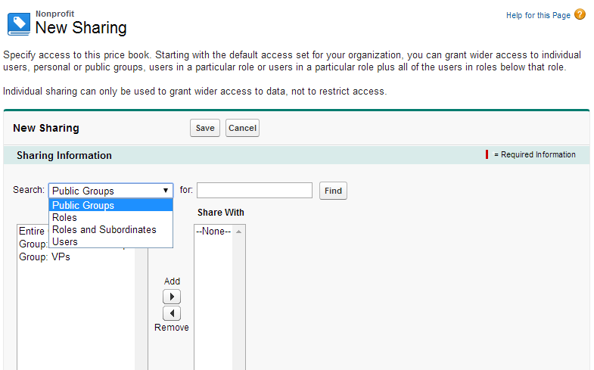
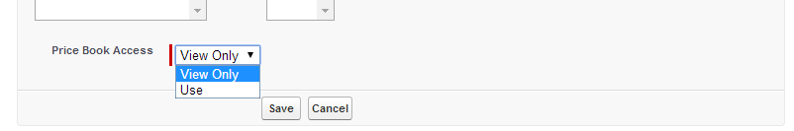
Giving Access to Price Books
If the organization-wide default is set to View Only or No Access, you can share each price book with public groups, roles, roles and subordinates, and users.
Notes:
Teaching Points:
If the OWD setting for Price Books is set to Use, then all users can access all price books.
If you decide there are users in the organization who should not have full use access to all price books, set the OWD to View Only or No Access, then provide access to standard and custom price books with the Sharing button on the price book.
Suggestions:
Ask “Would your organization want to restrict access to Price Books from some users?”

Slide 33
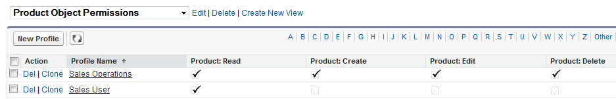
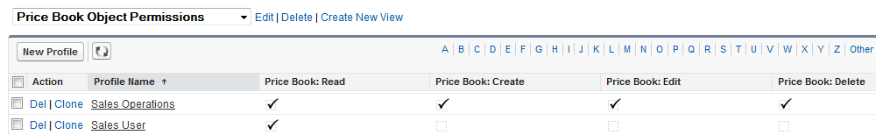
Setting Permissions
Object permissions can be set for Price Books and Products.
The “Edit” permission on Price Books gives access to all Price Books.
The “Edit Opportunity Product Sales Price” app permission allows users to change the sales price on opportunity products.
NOTE:
Notes:
Teaching Points:
An important caveat when granting access to price books: users with Edit permission on the Price books (whether from their Profile or through a permission set) are granted access to all price books, regardless of the Organization-Wide Defaults.
To prevent any user from being able to see all price books, remove this Edit permission from their Profile and any Permission Sets they’re assigned. (In addition to setting the OWD to No Access.)
In this example, only the Admin and the Sales Operations profile have Edit access.
Suggestions:
Ask “Who in your organization should have Edit permission?”

Slide 34
1-8: Control Access to Products and Price Books
Your turn:
Goal:
Prevent users from adding products from specific price books to opportunities.
10 minutes
Tasks:
Change the organization-wide default setting for the Price Books object to View Only.
Share the Enterprise - APAC price book with Roles and Subordinates of the APAC Sales Director with Use access.
Log in as Jin Chang, an APAC Sales Rep, and verify that he can view price books and add products from the Enterprise - APAC price book to an opportunity.
Log in as Anna Bressan, a US Sales Rep, and verify that she can view price books but not add products from any price book to an opportunity.

Slide 35
Module Agenda
Creating and Customizing Products
Creating and Customizing Custom Price Books
Adding Products to Opportunities
Controlling Access to Products and Price Books
Creating Quotes
Creating Orders
Integrating Salesforce with Other Systems

Slide 36

Creating a Quote
Opportunity
Opportunity Products
Quote
+
=
When a quote is created, products on an opportunity will be added to the quote.
From the quote, products can be added, edited, and given discounts on a per-item basis.
Taxes and shipping costs are added to the total.
A quote is created from an opportunity and its products to show proposed prices for products and services.
NOTE:
Notes:
Teaching Points:
A quote is a record showing proposed prices for products and services. A quote is created from an opportunity and its products.
When a quote is saved:
A unique quote number is added.
Any products on the opportunity are copied to the quote as line items.
The grand total is recalculated based on any taxes or shipping information you entered.

Slide 37
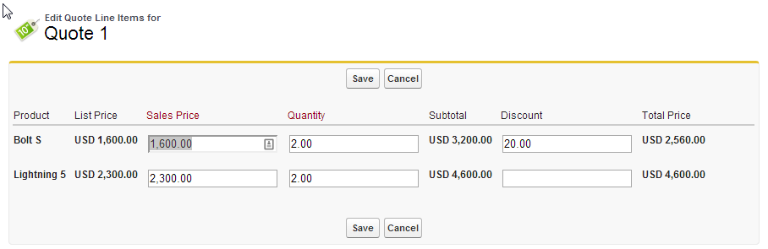
Editing Quote Line Items
You can edit quote line items to apply discounts to individual products.
Notes:
Teaching Points:
You can edit quotes to update quantities or items as the deal progresses.
When using quotes, you can apply discounts to individual quote line items.

Slide 38


Syncing a Quote to Its Opportunity
Sync all updates between a quote and the opportunity it was created from.
When you sync a quote to an opportunity for the first time, the products on the quote are copied to the opportunity.
Opportunity
Product A …. $100
Product B …. $70
Quote
Product A …. $100
Product B …. $70
While synced, any change made to the opportunity will be reflected in the quote, and vice versa.
Opportunity
Product A …. $100 Product B …. $70
Quote
Product A …. $100
Product B …. $70
Notes:
Teaching Points:
Quotes syncing lets you link a quote to the opportunity it was created from and synchronize all updates between the two records.
When a quote and an opportunity are synced, any change to line items in the quote will sync with products on the opportunity, and vice versa.
If you’ve made any changes to the quote since you created it from the opportunity, the opportunity will be updated when you sync.

Slide 39

Creating Multiple Quotes
You can create a set of quotes to show different combinations of products, quantities, and discounts.
Quote 1
Product A …. $100
Product B …. $70
Initial quote presented to customer.
Opportunity
Product A …. $85
Product B …. $50
Product C …. $120
Quote 2
Product A …. $100
Product B …. $70
Product C …. $150
Second quote with additional products.
Quote 3
Product A …. $85
Product B …. $50
Product C …. $120
Third quote with negotiated discount applied to products.
Notes:
Teaching Points:
Each opportunity can have multiple associated quotes, to show customers varying combinations of products and prices. These can also provide a record of the stages of a negotiation.
In our exercise, the Quotes are named simply Quote 1 and Quote 2. Best practice suggests using a naming convention that includes the account name and some identifying information, such as “Rochir -10 Laptops – Quote 1”.

Slide 40
Synchronizing an Opportunity with One Quote
An opportunity can have multiple quotes, but it can only sync with one quote at a time.
Quote 1
Product A …. $110
Product B …. $75
Product C …. $165
Quote 2
Product A …. $100
Product B …. $70
Product C …. $150
Opportunity
Product A …. $85
Product B …. $50
Product C …. $120
Quote 3
Product A …. $85
Product B …. $50
Product C …. $120
Notes:
Teaching Points:
Multiple quotes can exist on an opportunity, but only one quote can be synced to an opportunity at a time.
When you sync a quote to an opportunity for the first time, the products on the quote are copied to the opportunity.
If you change the quote that syncs to the opportunity, the opportunity will be updated with the products and prices listed on the synced quote.

Slide 41
Creating PDF and Sharing Quotes
41
When your quote is complete, you can generate a PDF and email it to your customer.
Quote
Product A …. $85
Product B …. $50
Product C…. $120
Quote
PDF
Notes:
Teaching Points:
When your quote is complete, generate a PDF using the “Create PDF” button at the top of the quote, and email it to your customer.

Slide 42
1-9: Create Multiple Quotes
Your turn:
Goal:
Create multiple quotes and sync one of the quotes to an opportunity.
5 minutes
Tasks:
Create a quote and sync it to the Rochir - Laptops opportunity.
Create a second quote and edit the quote line items.
Sync the second quote to the opportunity.
Generate a PDF of the quote.

Slide 43
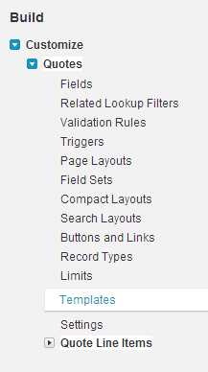
Customizing Quotes
Customize page layouts to add or remove fields.
Use standard Salesforce PDF templates or create your own.
Setup | Customize | Quotes | Settings | Enable Quotes
CLICK PATH:
Notes:
Teaching Points:
After you enable quotes, select the page layouts that should include the Quotes related list on the Page Layout Selection page.
In Enterprise, Unlimited, Performance, and Developer Editions, you can activate record types on quotes to determine the picklist values and business processes available when users create or edit a record.
Quote PDFs are based on templates. Salesforce offers a standard template, and you can also create your own.
Use quote templates to design, preview, and activate custom templates for the quotes you send to your customers.
The quote templates feature looks and works a lot like the enhanced page layout editor.

Slide 44
How Do Quotes Relate to Opportunities and Products
Use Schema Builder to determine how these objects relate to each other.
Quote
Opportunity
Product
Price Book
Quote Line Item
Opportunity
Product
Price Book Entry
Setup | Schema Builder
CLICK PATH:
Notes:
Teaching Points:
*This slide has an animation to appear the lines for Quotes and Quote Line Items*
Have students go into Schema Builder in their orgs and select Quote, Quote Line Item, Opportunity, Opportunity Product, Product, Price Book, and Price Book Entry.
In addition to lookup relationships, we now have some Master-Detail relationships indicated in red.
Suggestions:
If you are short on time, have students guess and then reveal the lines on the slide without going into Schema Builder.
The student guide shows this diagram with no lines filled in for the Quote and Quote Line Item objects – students can draw in the relationships in their printed student guide or on a piece of paper.
Note:
This slide has an animation to appear the connecting lines.

Slide 45
Module Agenda
Creating and Customizing Products
Creating and Customizing Custom Price Books
Adding Products to Opportunities
Controlling Access to Products and Price Books
Creating Quotes
Creating Orders
Integrating Salesforce with Other Systems

Slide 46




Orders and Contracts
An order is an agreement between a company and a customer to deliver products or services with a known quantity, price, and date.
DEFINITION:
An order can be associated directly to an account.
Account
Order
A contract is a written agreement between companies that defines the terms for doing business.
DEFINITION:
The order can also be associated to a contract (which is associated to an account).
Account
Contract
Order
Notes:
Teaching Points:
An order is an agreement between a company and a customer to provision services or deliver products with a known quantity, price, and date.
You can add orders directly to an account, or your company may require orders to be added to a contract.
You can create an order directly on an account or contract, through its Orders related list, to automatically associate the order with that record.
You can also create an order from the Orders tab and manually add the associated account and contract, if necessary.
For example, an Internet service provider may require customers to commit to a year of service. That company would require contracts as a reference for every order.
A company that sells clothing might sell products in a single transaction. That company would associate each order directly with an account.
Orders are a generally available feature since Spring ‘14.
Suggestions:
Ask “Does your company use contracts?”

Slide 47
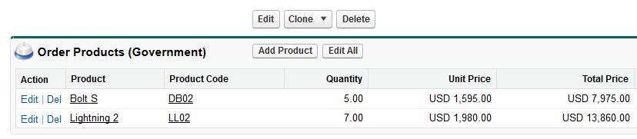
Adding Products to an Order
An order product is a product or service on an order. All order products on an order must be associated with the same price book.
From an Order:
Price Book
Order Products
Notes:
Teaching Points:
Keep track of what you’re selling to a customer by adding products to their order records.
When products are associated with orders, they become order products. Order products can be added to draft orders.
All order products in an order are associated with a price book (indicated in parentheses in Order Products related list).
Choose a price book that contains products with the same currency as the order.
To create an order with the same details as another order, you can clone it.
Note: If you clone products, you can’t change the new order's currency or price book.

Slide 48
How Do Orders Relate to Contracts and Accounts?
Account
(optional)
Contract
Order
Order Product
Setup | Schema Builder
CLICK PATH:
Notes:
Teaching Points:
*This slide has an animation.*
Have students go into Schema Builder in their orgs. Select Account, Contract, Order and Order Product.
These are lookup relationships – which object is the parent and which is the child in these lookup relationships?
In which direction would you draw the one-to-many relationships?
Suggestions:
The student guide shows this diagram with no lines filled in between the objects – students can draw in the relationships in their printed student guide or on a piece of paper.
Note:
This slide has an animation to appear the connecting lines.

Slide 49
How Do These Objects Relate to Each Other?
Opportunity
Opportunity Product
Account
Product
(optional)
Contract
Order
Order Product
Quote
Quote Line Items
Notes:
Teaching Points:
This ERD show how all the objects we’ve talked about so far relate to each other.
Look up relationships are in blue and master-detail relationships are in red.

Slide 50
1-10: Create an Order with Products
Your turn:
Goal:
Create an order with products.
5 minutes
Tasks:
Create an order.
Add Products to the order from the Enterprise – APAC price book.
Account | Rochir
Contract | 00000106
Start date | The last day of next month.
Product | Quantity
Lightning 2 | 10
Lightning 5 | 20

Slide 51
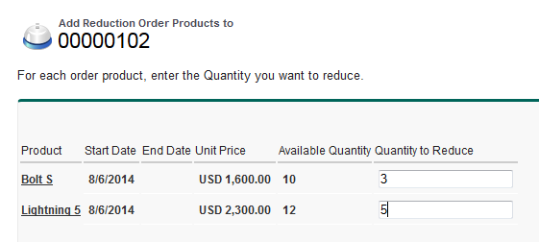
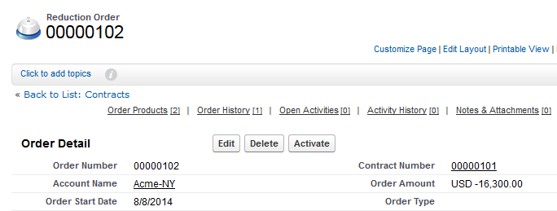
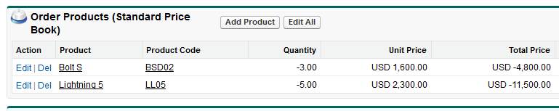
Reducing an Order
Track a customer’s request to reduce, return, deactivate, or disable products or services using reduction orders.
Or create an order with a negative quantity:
Notes:
Teaching Points:
What if you need to process product returns from an order? There are two ways to process returns:
In some companies these are referred to as change order requests.
Use reduction orders to track a customer’s request to reduce, return, deactivate, or disable products or services.
Each reduction order product is directly associated with an order product. Reduction order products are available in EE and up.
Another option is to create a separate order for a negative quantity; this record will not have a tie to the original order or order product.
Negative quantities might be used to process customer returns that cover several orders, to avoid having to create a reduction order on each order.
Organizations PE and below must use negative quantities to process returns.
Extra materials:
This could be a brief demo.
1) First, enable Reduction Orders under Orders > Settings.
2) Go to the detail page of the order you’re reducing.
3) Click Reduce Order to create a reduction order.
4) Enter the appropriate details for the reduction order, and click Save.
5) Add products to indicate which order products on the original order need to be reduced.

Slide 52




Generate Orders Automatically
The Generate Orders app on the Salesforce AppExchange lets you create an order from the line items on an opportunity or quote.
Opportunity
5 Product A …. $100
2 Product B …. $70
Generate Order
Order
5 Product A …. $100
2 Product B …. $70
Products, quantities, and prices are added to the order.
The order is automatically linked to its associated opportunities, quotes, accounts, and contracts.
Notes:
Teaching Points:
The “Generate Orders” app from Salesforce Labs automatically generates a complete order with the click of a button from Opportunities. Use the similar “Generate Orders (w/ Quotes)” to create Orders (and/or Contracts) directly from Opportunities or Quotes.
A Generate Orders button can be added to your opportunity or quote to streamline the order create process for your sales and operations teams.
The Generate Orders package comes with a set of custom buttons and Flow templates, which you can tailor to match your business requirements.
Generate Orders is available in Enterprise, Performance, Unlimited, and Developer Editions.
Note:

Slide 53
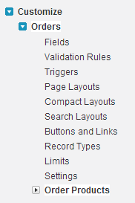
Customizing Orders
An administrator can also control access to orders.
Set the object permissions.
Enable the “Activate Orders” and “Edit Activated Orders” app permissions.
Setup | Customize | Orders
CLICK PATH:
Notes:
Teaching Points:
The orders and order products object can be customized like other objects by:
Adding custom fields
Setting up record types
Setting up validation rules
Customizing layouts
Administrators can also control access to orders.
A reduction order is an agreement between a company and a customer to process product returns, de-provision services, or reduce services that have been provisioned.
Orders must first be enabled for an organization by the admin. Then, the admin must select enable reduction orders. Once enabled, users need the “create reduction orders” permission to create reduction orders.

Slide 54
Module Agenda
Creating and Customizing Products
Creating and Customizing Custom Price Books
Adding Products to Opportunities
Controlling Access to Products and Price Books
Creating Quotes
Creating Orders
Integrating Salesforce with Other Systems

Slide 55
Integrations Discussion
In addition to the sales department, who interacts with product and order information?
What systems do they rely on?
Notes:
Teaching Points:
This discussion is to get students thinking about the business processes related to products and orders that involve multiple departments and systems.
Possible answers include:
Accounts receivable, accounts payable, inventory, warehouse, shipping, order fulfillment, sales operations, sales compensation, marketing…
ERP systems like SAP or Oracle; QuickBooks; project management and resource planning systems; business intelligence and analytics system.

Slide 56
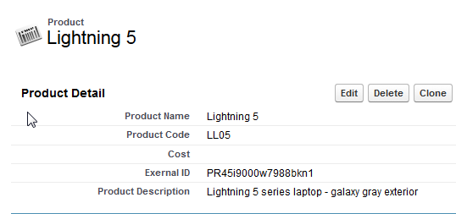
Linking to External Systems
Use a custom field to store the external ID from another system to allow data to map to the correct record during system integrations.
Notes:
Teaching Points:
When integrating Salesforce with external systems, external IDs allow the data in Salesforce to map to the correct record in an external system.
You can create a custom field on products, price book entries, opportunity products, and order products to create these links.
When creating a custom field, select the External ID checkbox to set the field to identify records from an external system.

Slide 57
CPQ Applications
Configure - Price - Quote refers to the process involved in calculating complex service offerings for customers:
DEFINITION:
What are the benefits?
Ensures bundling and discounting rules are applied correctly
Increases efficiency and reduces errors
Works together with approval and authorization workflows in Salesforce
Can be deployed in self-service sales environments and across multiple channels
CONFIGURE: Assembly of services and products.
PRICE: Accounts for variables and then determines pricing structure.
QUOTE: Formulates a proposal that outlines cost.
Notes:
Teaching Points:
Configure, price and quote (CPQ) applications support configuration, pricing, and quote generation activities. CPQ is sometimes known as quote-to-cash.
CPQ systems typically include pricing engines, proposal generators, quoting systems, and rules or constraint engines, and work together with the approval and authorization workflows in Salesforce.
CPQ solutions may be especially useful for solution and negotiated selling. They can be deployed in self-service sales environments and across multiple channels.
Suggestions:
Ask “What aspects of CPQ might be useful? Do you use CPQ? What other Quote and Order solutions might help you?”

Slide 58
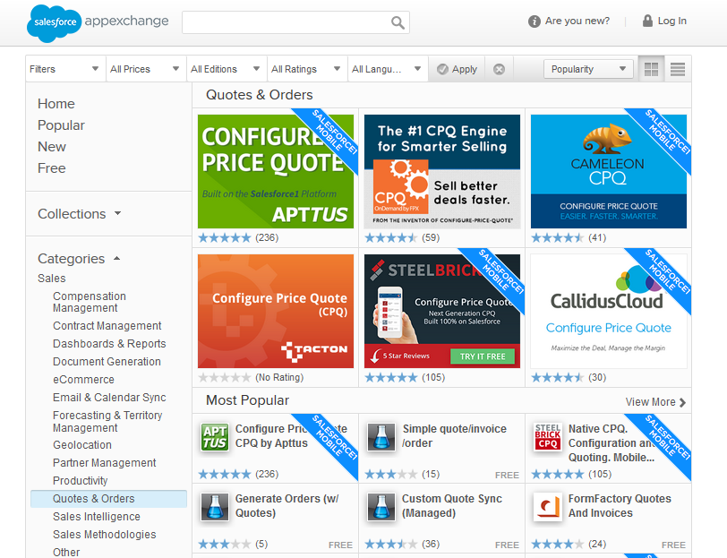
Salesforce AppExchange Solutions
Several AppExchange applications offer quote and order solutions to meet your organization’s particular needs.
Notes:
Suggestions:
Have students go to the AppExchange and browse the CPQ solutions as well as others in the Quotes & Orders section to read about various CPQ solutions and what else is offered.
You should always perform your own due diligence before implementing a CPQ solution.

Slide 59
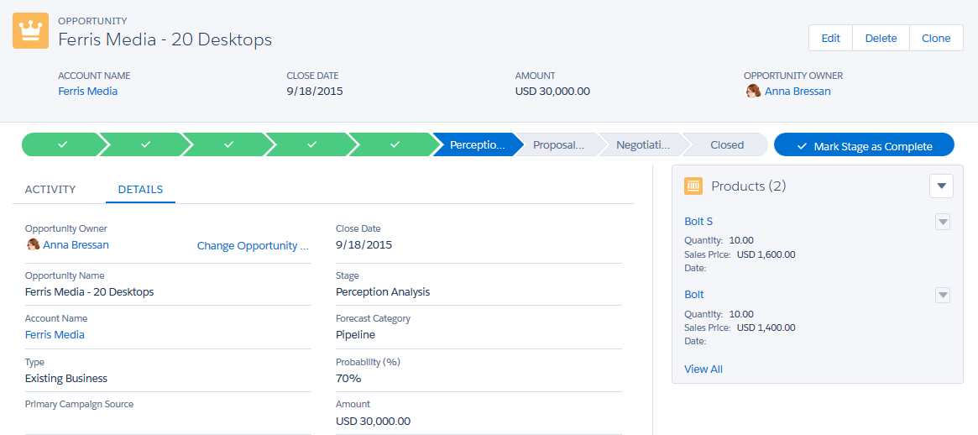
Products and Price Books in the Lightning Experience
Notes:
Teaching Points:
The Lightning Experience is a new user interface designed to helps sales reps find and enter data more easily and close deals faster.
In its initial release (Winter ‘16), Lightning Experience supports Products and Price Books.
Lightning Experience merges a product’s standard and custom price book entries into a single Price Books related list. This is different from Salesforce Classic, which has separate related lists for Standard Prices and Price Books.If you previously removed the Price Books related list because your org uses standard prices only, you should add it back to the Product page layout so your users can see standard prices in Lightning Experience.
For organizations already activated, the Add to Price Book page doesn’t include the Use Standard Price option by default. To make Use Standard Price available, add it to your Price Book Entry page layouts. For organizations already activated, the Price Books home page doesn’t include an All Price Books list view by default. We recommend creating this list view to give your users access to price book records
Please see the Winter ’17 release notes for more information so you can decide if Lightning Experience is right for some or all of your users.
Opportunity Product Limitations
Users can add only one product to opportunities or price books at a time in Lightning Experience. It’s not yet possible to select multiple products from a list.
Users can add products with schedules in Lightning Experience, but must switch back to Salesforce Classic to enable product schedules, or to establish or modify schedules for products.
Opportunities with products can't be cloned.

Slide 60
Knowledge Check
The sales organization started selling keyboards and mice. They want to track these products in Salesforce as computer accessories. They also want to track the various prices at which the products are sold. How can an administrator accomplish this?
What steps must a user take to add a product to an opportunity record?
What happens when a user syncs a quote to an opportunity?
What object tracks the products, including quantity and price, that the customer has agreed to purchase?
The sales organization stores product information in an Enterprise Resource Planning (ERP) system. They want to integrate Salesforce with the ERP system. How can an administrator link the products between these two systems?
Notes:
Teaching Points
Use the Knowledge Check Manager in place of this slide. 1. An administrator can add a product to a family for computer accessories, create new products for each keyboard and mouse, and add the product list prices to standard and custom price books. 2. To add a product to an opportunity record, a user must first choose the price book. Then the user can select the products to add. Finally, the user can set the quantity for each product. Remember that all products added to an opportunity record must come from the same price book. Once products are added to an opportunity, you can no longer manually control the opportunity amount. 3. When a quote is created, products on an opportunity are added to the quote. When you sync a quote to an opportunity for the first time, the products on the quote are copied to the opportunity. While synced, any change made to the opportunity will be reflected in the quote, and vice versa. An opportunity can have multiple quotes, but it can only sync with one quote at a time. 4. An order is an agreement between a company and a customer to deliver products or services with a known quantity, price, and date.
5. An administrator can create a custom external ID field on the Product object to link products between Salesforce and an external system.

Slide 61
Module 2: Set Up Collaborative Forecasts

Slide 62
Group Discussion
How does your sales organization currently track forecasts and quotas?
What data does your sales organization use to determine the forecast?
How does your sales organization use forecast data to drive business decisions?
Notes:
Teaching Points:
These questions were given as pre-work when they signed up for the course. If the students did not fill out the pre-work, they can just answer them during class.
The goal of these questions is to get students thinking about how their sales organization currently uses forecasting to make business decisions.
Extra Materials:
Here are some common answers that you might get from students:
Question 1: Microsoft Excel spreadsheets, Customizable Forecasting in Salesforce, Using the Opportunity Probability field in Salesforce to calculate expected revenue, we don’t currently forecast
Question 2: Expected sales revenue, projected number of units
Question 3: Set head count based on sales revenue predictions and inventory needs
Suggestions:
Have the students pair up with another student to discuss their answers. When you reconvene, ask each pair of students to answer one of the questions.
OR
Call on different students to answer these questions about their own organizations.
Virtual Delivery:
Use break out rooms to allow students to discuss these questions in smaller groups.
OR
Ask these questions one at a time. For each question, have them chat their answers. Highlight the common themes across different answers.

Slide 63
Generate Accurate Forecasts
Allison Wheeler
VP Global Sales
“We want to generate accurate forecasts and track quota attainment in Salesforce.”
To accomplish this, you need to:
Describe the capabilities of Collaborative Forecasts.
Enable forecasts for users.
Configure multiple forecast types.
Map opportunity stages to forecast categories.
Define forecast managers and enable adjustments.
Add quota data for users.
Build reports to track forecast and quota data.
Notes:
Extra Materials:
Allison Wheeler is a VP of Global Sales. Her team uses Salesforce to manage the entire sales process from lead generation and qualification to moving deals through the sales pipeline and winning the deal.
The sales team is currently using spreadsheets to manage their quarterly forecast and quota data.
Instead Allison wants to use Collaborative Forecasts in Salesforce to generate accurate forecasts and track quota attainment.
Note – This course will not cover Customizable Forecasting. To learn about the differences between Collaborative Forecasts and Customizable Forecasting, search for difference between forecasting features in Help & Training. Please note that Collaborative Forecasts does not currently support Territory Management.
Starting in Spring ’16, businesses that use Custom Fiscal Years can now use Collaborative Forecasts. Collaborative Forecasts can now calculate expected revenue for your custom fiscal periods or quarters.
Starting with Winter '12, all new Salesforce customers have Collaborative Forecasts.

Slide 64

What Makes Up a Forecast?
Opportunity Owner
Amount
Quantity
Close Date
Stage
Forecast Category
Matt Wilson
$20,000.00
20
10/17/2016
Prospecting
Pipeline
Matt Wilson
$15,000.00
10
11/28/2016
Id. Decision Makers
Commit
Matt Wilson
$35,000.00
30
12/13/2016
Closed Won
Closed
$70,000.00
60
Forecast User
Forecast Period
Forecast Category
Revenue Forecast
Quantity Forecast
A forecast is an expression of the expected sales revenue or projected number of units sold based on opportunities in the pipeline.
DEFINITION:
Notes:
Teaching Points:
Let’s assume that Matt Wilson has three opportunities in the sales pipeline.
The Opportunity Owner field determines the Forecast User.
For each opportunity record, Matt captures the opportunity amount in the Amount field. Revenue Forecast is the total amount of opportunities in the sales pipeline. In this example, Matt’s revenue forecast is $70,000.
Matt uses the opportunity Quantity field to capture the number of units being sold. Quantity forecast is the total number of units across opportunities in the sales pipeline. In this example, Matt’s quantity forecast is 60 units.
The Close Date field determines the Forecast Period.
The Stage field determines the value of the Forecast Category field. The Forecast Category field determines the Forecast Category on the forecast.
In addition to forecasting based on the Amount field, Collaborative Forecasts lets you forecast on custom currency fields on opportunities.

Slide 65
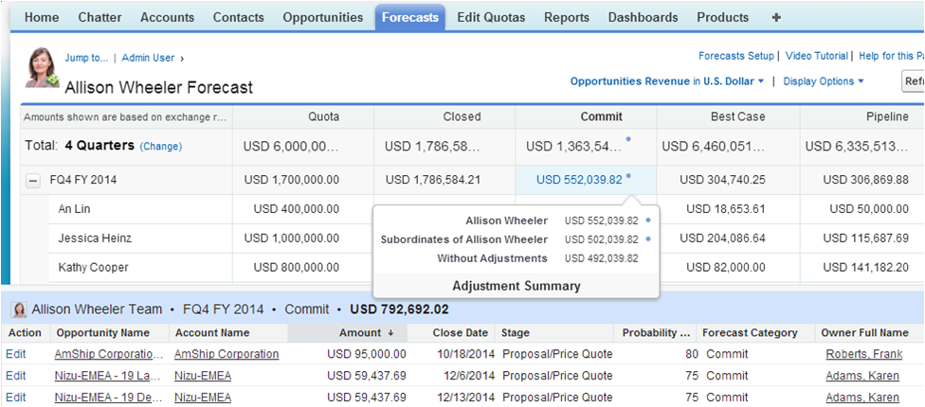
Collaborative Forecasts Overview
Forecast User
Forecast Type
Forecast Category
Forecast Period
Currency
Quota
Opportunities
Adjustments
Organizations using Communities can include partner-owned opportunities in forecasts.
NOTE:
Notes:
***Slide for Classroom Training***
Teaching Points:
The Forecasts tab displays forecast and quota information and allows forecast managers to make adjustments to the forecast.
Displays the forecast for the Forecast User and their immediate subordinates. An Lin, Jessica Heinz, and Kathy Cooper are directly below Allison in the hierarchy.
Displays the forecast for the each Forecast Period. The forecast period can be quarterly or monthly.
Displays the forecast for each Forecast Category. The forecast categories are Closed, Commit, Best Case, and Pipeline. Forecast categories are mapped to opportunity stages.
Allows a forecast user to change the Forecast Type. The supported forecast types are Opportunities Revenue, Opportunities Quantity, Product Family Revenue, Product Family Quantity, Opportunity Revenue Splits, Opportunity Overlay Splits Revenue, and Custom Field Revenue. An administrator can enable up to four forecast types for an organization.
Allows a forecast user to change the Currency displayed on the Forecasts tab.
Allows forecast managers to make Adjustments to the forecast of direct subordinates to increase the accuracy of forecasts. It also allows forecast users to adjust the amount of their own forecast.
Displays the Opportunities that make up the forecast. When you click on a forecast value, the opportunity pane displays only the opportunities that make up the selected forecast value.
Displays the Quota for each forecast user. From the Display Options drop down, user can display the percentage of quota attainment.
Organizations using Communities or the Partner Portal can include partner-owned opportunities in forecasts. This allows sales managers to view the forecast for their direct sales team, as well as the forecast for partners. Although partner opportunities are visible in the forecast, Community and Partner Portal users do not have access to the Forecasts tab or any of its functionality.
Suggestions:
Use an end state org and point out these capabilities from the Forecasts tab.

Slide 66
Module Agenda
Enabling Forecasts for Users
Forecasting by Opportunities
Mapping Opportunity Stages to Forecast Categories
Defining Forecast Managers and Enabling Adjustments
Adding Quota Data
Forecasting by Product Family
Forecasting by Opportunity Splits and Custom Fields
Building Reports

Slide 67

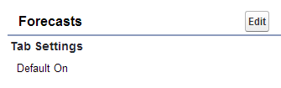
Enabling Forecasts for Users
The Allow Forecasting setting on user records allows users to forecast.
Tab Settings on profiles control the visibility of the Forecasts tab.
User
Allison Wheeler
Profile
Sales User
Profile
Executive User
Notes:
Teaching Points:
You must enable forecasting for users and ensure that the Forecasts tab is visible.

Slide 68
2-1: Enable Forecasts for Users
Your turn:
Goal:
Allow all users in the sales organization to forecast.
5 minutes
Tasks:
Enable forecasting for the VP of Global Sales and all US sales users.
Note: Forecasting has already been enabled for sales users in EMEA and APAC.
Make the Forecasts tab visible for the Sales User and Executive User profiles.
VP Global Sales Allison Wheeler
US Sales Director Kathy Cooper
US Sales Reps
Anna Bressan
Frank Roberts
Matt Wilson

Slide 69
Module Agenda
Enabling Forecasts for Users
Forecasting by Opportunities
Mapping Opportunity Stages to Forecast Categories
Defining Forecast Managers and Enabling Adjustments
Adding Quota Data
Forecasting by Product Family
Forecasting by Opportunity Splits and Custom Fields
Building Reports

Slide 70
Forecasting by Opportunities
The forecast type determines the type of data and measurement to display in the forecast.
DEFINITION:
You can add forecast types to display the expected revenue or quantity from opportunities.
Forecast Type = Opportunities (Revenue)
Forecast Type = Opportunities (Quantity)
Opportunity Owner
Matt Wilson
Opportunity Owner
Matt Wilson
Amount
$20,000.00
Quantity
20
Setup | Customize | Forecasts | Settings
CLICK PATH:
Notes:
Teaching Points:
You can enable up to four forecast types for the organization.
You can set the forecast type to Opportunities, Product Families, Opportunity Revenue Splits, Opportunity Overlay Splits, or a custom field.
When you set the forecast type to Opportunities, you can set the forecast measurement to Revenue or Quantity.
When the forecast type is Opportunities (Revenue), the forecast is based on the opportunity owner and amount.
When the forecast type is Opportunities (Quantity), the forecast is based on the opportunity owner and quantity.
You can control which fields display in the Opportunities pane of the Forecasts tab.
Removing a forecast type deletes all of its quota and adjustment data.
Disabling Collaborative Forecasts deletes adjustments and quotas for all active forecast types.

Slide 71
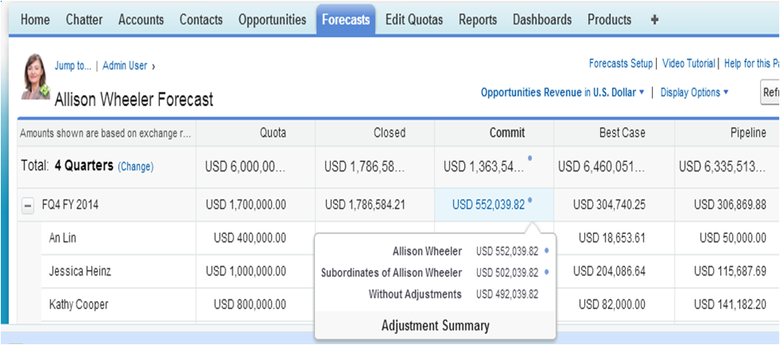
Configuring Forecast Settings
Forecast settings allow you to enable forecast adjustments and configure the default forecast display.
Display separate or cumulative rollup columns
Default currency
Show quotas
Forecast period and default range
Enable adjustments
Setup | Customize | Forecasts | Settings
CLICK PATH:
Notes:
Teaching Points:
This slide shows what forecasts settings control on the Forecast tab:
Enable or disable forecast adjustments for the organization. The settings control if the forecast can be adjusted. The adjustment settings can be set at the manager level and the owner level independently.
Administrators can allow all forecast users, including both sales reps and managers, to adjust forecast amounts.
Enable manager adjustments allow forecast mangers to adjust the forecast amounts of their immediate subordinates.
Enable owner adjustments allow all forecast users to adjust the forecast amount of their own forecast.
Set the forecast period to Monthly or Quarterly and control which forecast periods display by default.
Set the default currency to the corporate currency or the forecast owner’s personal currency.
The default forecast display includes separate rollup columns for opportunities in each individual forecast category--Closed, Commit, Best Case, and Pipeline. You can choose instead to display cumulative rollup columns, which include opportunities in more than one category.
Display quotas and attainment percentages.
Changing the Forecast Period deletes adjustments and quotas for all active forecast types.

Slide 72
2-2: Add a Forecast Type for Opportunities (Quantity)
Watch me:
Goal:
Allow users to view the forecast based on opportunity quantity.
5 minutes
Tasks:
Add a forecast type for Opportunities (Quantity) that includes the Region / Zone field in the Opportunities pane.
Note: Forecasts has already been enabled.
Review the default forecast settings.
Notes:
Suggestions:
Students can follow along (like a Join Me) if they choose. If they follow along, a couple of steps in the next exercise will change slightly.
This exercise is NOT a dependency for other exercises.
Extra Materials:
Forecasts has already been enabled in the org. It had to be enabled in order to install the Edit Quotas app.

Slide 73
2-3: Add a Forecast Type for Opportunities (Revenue)
Your turn:
Goal:
Allow users to view the forecast based on opportunity revenue.
5 minutes
Tasks:
Add a forecast type for Opportunities (Revenue) that includes the Region/Zone field in the Opportunities pane.
Configure the forecast settings.
Enable Manager Adjustments | Select
Enable Owner Adjustments | Select
Enable Cumulative Forecast Rollups | Deselect
Forecast Period | Quarterly
Starting On | Current quarter
Display | 4 quarters
Forecast Currency | Corporate Currency (U.S. Dollar)
Show Quotas | Select
Notes:
If students did the Watch Me exercise 2-2, they will see a pop-up warning about data being deleted. They can ignore the warning and click Delete Data.

Slide 74
2-4: View the Impact of Changing the Forecast Settings
Your turn:
Goal:
View the impact of the forecast settings on the forecast.
10 minutes
Tasks:
Log in as Karen Adams, an EMEA Sales Rep.
Answer questions about her forecast.
Which forecast periods are displayed by default?
How can Karen modify the displayed forecast periods?
Which currency is displayed by default?
How can Karen modify the currency?
What happens when you click on a cell in the forecast table?
What fields display in the Opportunities pane?
Why is the Quota column empty?
Why are the Commit and Best Case forecast categories empty?
Notes:
Teaching Points:
Which forecast periods are displayed by default?
Current and next three quarters
How can Karen modify the displayed forecast periods?
Click Change next to 4 quarters.
Which currency is displayed by default?
U.S. Dollar
How can Karen modify the currency?
Click Opportunities Revenue in U.S. Dollar | Change currency…
What happens when you click on a cell in the forecast table?
The opportunity pane displays the opportunities that make up the selected forecast value.
What fields display in the Opportunities pane?
Opportunity Name, Account Name, Amount, Close Date, Stage, Probability (%), Forecast Category, Owner Full Name, Region / Zone
Why is the Quota column empty?
Because you have not loaded any quota data
Why are the Commit and Best Case forecast categories empty?
Because you have not mapped opportunity stages to forecast categories.
Suggestions:
When the students have finished the exercise, tell the students the answers and ask if anyone had different answers. For questions that students got wrong, show the students how to find the answers in the UI.

Slide 75
Module Agenda
Enabling Forecasts for Users
Forecasting by Opportunities
Mapping Opportunity Stages to Forecast Categories
Defining Forecast Managers and Enabling Adjustments
Adding Quota Data
Forecasting by Product Family
Forecasting by Opportunity Splits and Custom Fields
Building Reports

Slide 76
Mapping Opportunity Stages to Forecast Categories
You need to define which opportunity stages map to each forecast category.
Opportunity Stage
Forecast Category
Opportunity Stage
Forecast Category
Prospecting
Proposal/Price Quote
Commit
Qualification
Pipeline
Negotiation/Review
Needs Analysis
Closed Won
Closed
Value Proposition
Closed Lost
Omitted
Id. Decision Makers
Best Case
Perception Analysis
You need to define which opportunity stages map to each forecast category.
Notes:
Teaching Points:
By default, all stages except Closed Won and Closed Lost are mapped to the Pipeline forecast category.
You need to define which opportunity stages map to each forecast category based on the different thresholds that increase the likelihood an opportunity will be won.

Slide 77

Forecast Categories
Forecast categories group opportunities together based on opportunity stage.
DEFINITION:
Closed | Commit | Best Case | Pipeline
$50,000.00 | $100,000.00 | $70,000.00 | $65,000.00
Closed Won
$30,000.00
Proposal/Price Quote
$40,000.00
Value Proposition
$25,000.00
Prospecting
$40,000.00
Closed Won
$20,000.00
Negotiation/Review
$25,000.00
Id. Decision Makers
$15,000.00
Qualification
$10,000.00
Negotiation/Review
$35,000.00
Perception Analysis
$30,000.00
Needs Analysis
$15,000.00
By default, each category displays the forecast for only the opportunities mapped to it.
Opportunities in the Omitted forecast category are not included in the forecast.
Sales reps can manually change the forecast category for an opportunity.
Notes:
Teaching Points:
By default, each category displays the revenue forecast or quantity forecast for only the opportunities mapped to that category.
Opportunities in the Omitted forecast category are not included in the forecast, since these are lost opportunities.
It is important for you to discuss the opportunity stage and forecast category with sales executives and managers. Sales executives and managers can leverage this to manage their sales teams and ensure forecast accuracy. For example, when a sales rep puts an opportunity in the Commit forecast category they are essentially signing it in blood that this deal will come through!
A sales rep can manually change the forecast category for an opportunity. Let’s say that a sales rep knows his customer really well. The customer might only be in the prospecting stage, but the rep wants to track this as a Best Case opportunity, because the customer almost always buys. Or maybe a customer often gets to the negotiation stage and then pulls out of the deal. The rep might want to track the opportunity in an earlier forecast category. Please note that changing the Opportunity Stage will override any manual changes to the forecast category. Users above the sales rep in the forecast hierarchy cannot change the forecast category on the opportunity.

Slide 78
Cumulative Forecast Rollups
You can select the Enable Cumulative Forecast Rollups checkbox to display cumulative rollup columns, which include opportunities in more than one category.
Column name in the Forecasts tab | Opportunities that roll up to it
Open Pipeline | Pipeline + Best Case + Commit
Best Case Forecast | Best Case + Commit + Closed
Commit Forecast | Commit + Closed
Closed Only | Closed
Your organization must choose whether you want to display individual forecast categories or cumulative forecast rollups.
NOTE:
Notes:
Teaching Points:
The default forecast display includes separate rollup columns for opportunities in each individual forecast category--Closed, Commit, Best Case, and Pipeline.
You can choose instead to display cumulative rollup columns, which include opportunities in more than one category:
Open Pipeline includes all opportunities mapped to Pipeline, Best Case, and Commit forecast categories.
Best Case Forecast includes all opportunities mapped to the Best Case, Commit, and Closed forecast categories.
Commit Forecast includes all opportunities mapped to the Commit and Closed forecast categories.
Closed Only includes all opportunities mapped to the Closed forecast category.
This setting also changes the column name displayed in the Forecasts tab.
To use cumulative forecast rollups, select the Enable Cumulative Forecast Rollups checkbox on the Setup | Customize | Forecast | Settings page.
Your organization must choose whether you want to display individual forecast categories or cumulative forecast rollups.
Be aware that changing the forecast column display purges all adjustments to Commit and Best Case forecast amounts.
Forecast Historical Trending can’t be used in organizations that use Cumulative Forecast Rollups.
Extra Material:
Cumulative forecast rollups has the same functionality as forecast categories in Customizable Forecasting.
Customizable Forecasting does not support displaying separate rollup columns for opportunities in each individual forecast category.

Slide 79
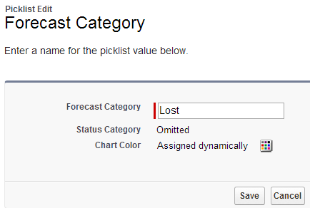
Changing Forecast Category Names
The standard forecast categories are Pipeline, Best Case, Commit, Closed, and Omitted.
You can change the forecast category names for your organization.
Notes:
Teaching Points:
You cannot add or remove forecast categories.

Slide 80
2-5: Map Opportunity Stages to Forecast Categories
Your turn:
Goal:
Define which opportunity stages map to each forecast category.
5 minutes
Stage | Forecast Category
Initial Contact | Pipeline
Quote Given | Best Case
Prospecting | Pipeline
Qualification | Pipeline
Needs Analysis | Pipeline
Value Proposition | Best Case
Id. Decision Makers | Best Case
Perception Analysis | Best Case
Proposal/Price Quote | Commit
Negotiation/Review | Commit
Closed Won | Closed
Closed Lost | Omitted
Task:
Map opportunity stages to forecast categories.
Notes:
Teaching Points:
The B2C Sales Process uses these stages: Initial Contact, Quote Given, Closed Won, Closed Lost.
The B2B Sales Process uses these stages: Prospecting, Qualification, Needs Analysis, Value Proposition, Id. Decision Makers, Perception Analysis, Proposal/Price Quote, Negotiation/Review, Closed Won, Closed Lost.

Slide 81
2-6: View the Impact of Mapping Opportunity Stages to Forecast Categories
YOUR TURN
Goal:
View the impact of mapping opportunity stages to forecast categories on the forecast.
5 minutes
Tasks:
Log in as Karen Adams, an EMEA Sales Rep.
Answer questions about her forecast.
What has changed about her forecast?
What displays in the opportunity pane when you click on a Best Case value?
What happens when you change the opportunity stage from Perception Analysis to Proposal/Price Quote?
What happens when you change the forecast category of an opportunity?
Notes:
Teaching Points:
What has changed about her forecast?
The Commit and Best Case forecast categories now include forecast values.
What displays in the opportunity pane when you click on a Best Case value?
Opportunities in the Value Proposition, Id. Decision Makers, or Perception Analysis stages
What happens when you change the opportunity stage from Perception Analysis to Proposal/Price Quote?
The opportunity now rolls up to the Commit forecast category.
What happens when you change the forecast category of an opportunity?
The opportunity now rolls up to the new forecast category. The opportunity stage does not change.
Suggestions:
When the students have finished the exercise, tell the students the answers and ask if anyone had different answers. For questions that students got wrong, show the students how to find the answers in the UI.

Slide 82
Module Agenda
Enabling Forecasts for Users
Forecasting by Opportunities
Mapping Opportunity Stages to Forecast Categories
Defining Forecast Managers and Enabling Adjustments
Adding Quota Data
Forecasting by Product Family
Forecasting by Opportunity Splits and Custom Fields
Building Reports

Slide 83



Forecast Hierarchy
The forecast hierarchy determines how forecasts roll up within the organization. It is automatically generated based on the role hierarchy.
DEFINITION:
Forecast Manager
VP Global Sales Allison Wheeler
View the forecast for Kathy and all US Sales Reps
Forecast managers can view the forecasts of users below them in the forecast hierarchy.
US Sales Director Kathy Cooper
View the forecast for all US Sales Reps
Forecast Manager
US Sales Reps Anna Bressan Frank Roberts Matt Wilson
Setup | Customize | Forecasts | Forecasts Hierarchy
CLICK PATH:
Notes:
Teaching Points:
You must enable users to act as forecast managers.
Only one person at each level in the forecast hierarchy can be a forecast manager at one time.
A forecast manager can view the forecasts of all users below them in the forecast hierarchy.
Users with the "View All Forecasts" permission can view any user’s forecast regardless of the forecast hierarchy.

Slide 84
Manager Adjustments
Manager adjustments allow forecast managers to adjust the forecast amounts of their immediate subordinates.
DEFINITION:
Forecast Manager
VP Global Sales Allison Wheeler
Managers must have the “Override Forecasts” permission to make adjustments.
Adjust Kathy’s forecast
US Sales Director Kathy Cooper
Forecast Manager
Adjust the forecast for all US Sales Reps
US Sales Reps Anna Bressan Frank Roberts Matt Wilson
Adjustments don’t change the individual opportunity amounts that roll up into the forecast. They just add a layer of detail.
NOTE:
Notes:
Teaching Points:
For example, a manager might think that a sales rep is being overly optimistic about the best case forecast. She can adjust his forecast for a specific forecast category to increase the forecast accuracy.
A subordinate cannot see his manager’s adjustments when viewing his forecast.
Suggestions:
Ask the students if Allison Wheeler can adjust the forecast for Anna Bressan? The answer is no, because Anna is not directly below Allison in the forecast hierarchy.

Slide 85
Owner Adjustments
Owner Adjustments allow forecast users to adjust the forecast amounts of their own forecast.
DEFINITION:
VP Global Sales Allison Wheeler
Allison can adjust her own forecast.
Users must have the “Override Forecasts” permission to make adjustments.
US Sales Director Kathy Cooper
Kathy can adjust her own forecast.
US Sales Reps Anna Bressan Frank Roberts Matt Wilson
Sales reps can adjust their own forecast.
Adjustments don’t change the individual opportunity amounts that roll up into the forecast. They just add a layer of detail.
NOTE:
CLICK PATH:
Notes:
Teaching Points:
Users have the power to make adjustments to their own forecasts without changing the underlying opportunity value.
For example, if a sales rep anticipates that her Commit forecast amount will come in higher, but isn’t sure which opportunities will provide the additional revenue, she can adjust her own Commit forecast amount.
If your organization uses product family forecasts, users can’t adjust their own product family forecast amounts.

Slide 86
2-7: Define Forecast Managers and Enable Adjustments
Your turn:
Goal:
Allow sales managers to view the forecasts of subordinates and adjust the forecasts of direct reports.
5 minutes
Tasks:
Define all sales managers as forecast managers.
Create a permission set that has the “Override Forecasts” permission enabled and assign it to Allison Wheeler.
Enable the “Override Forecasts” permission for the Sales User profile.
VP Global Sales Allison Wheeler
US Sales Director
Kathy Cooper
EMEA Sales Director
Jessica Heinz
APAC Sales Director An Lin
Sales Managers

Slide 87
2-8: View the Impact of Defining Forecast Managers and Enabling Adjustments
Watch me:
Goal:
View the impact of defining forecast managers and enabling adjustments on the forecast.
10 minutes
Tasks:
Log in as Kathy Cooper, the US Sales Director.
View the forecast for her sales reps, Anna Bressan and Frank Roberts.
From Kathy’s forecast, increase Frank’s Commit forecast for the current fiscal quarter by $10,000.
Log in as Allison Wheeler, the VP of Global Sales.
View the forecast for Kathy Cooper and Frank Roberts.
From Allison’s forecast, increase Kathy’s Commit forecast for the current fiscal quarter by $50,000.
Log in as Anna Bressan, a US Sales Rep.
View Anna’s Commit forecast for the current fiscal quarter and increase it by $10,000.
Notes:
Teaching Points:
Making an adjustment just adds a layer of detail. It does not change the individual opportunity amounts that make up the forecast.
Forecast managers can add adjustment notes to allow others to understand the reason for the adjustment.
Answers to questions in the Exercise Guide:
2-B: What is Anna's Commit forecast for the current fiscal quarter? dependent on the org data
2-D: What is Frank's Commit forecast for the current fiscal quarter? dependent on the org data
3-F: What is the adjusted forecast value? Me value
What is the forecast value without adjustments? Without Adjustments value
5-B: What is Frank's Commit forecast for the current fiscal quarter? Amount including Kathy’s adjustment
5-C: What is Frank's Commit forecast for the current fiscal quarter? Amount without Kathy’s adjustment
Why are these values different? When viewing Kathy’s forecast, you see Frank’s forecast including her adjustment.
6-F: What values appear in the adjustment summary? Me, Kathy Cooper and Subordinates, Without Adjustments
Extra Materials:
As the instructor, you need to perform all of the Your Turn exercises in order to do this Watch Me.

Slide 88
Module Agenda
Enabling Forecasts for Users
Forecasting by Opportunities
Mapping Opportunity Stages to Forecast Categories
Defining Forecast Managers and Enabling Adjustments
Adding Quota Data
Forecasting by Product Family
Forecasting by Opportunity Splits and Custom Fields
Building Reports

Slide 89
Quotas
A manager’s quota equals the amount the manager and team are expected to generate together.
FQ2 | Revenue Quota | Quantity Quota
 | $850,000.00 | 900
 | $300,000.00 | 250
 | $250,000.00 | 300
 | $200,000.00 | 200
Kathy Cooper
Sales Director
Frank Roberts
Sales Rep
Matt Wilson
Sales Rep
Anna Bressan
Sales Rep
A quota is the sales goal assigned to a sales user on a monthly or quarterly basis. Users can have both revenue quotas and quantity quotas.
DEFINITION:
Notes:
Teaching Points:
Quotas for sales managers are not automatically generated from their subordinates quotas.
In this example, the Quota for sales reps totals $750k. The quota for the sales director is $850K. This means the sales director is expected to generate $100k herself.

Slide 90
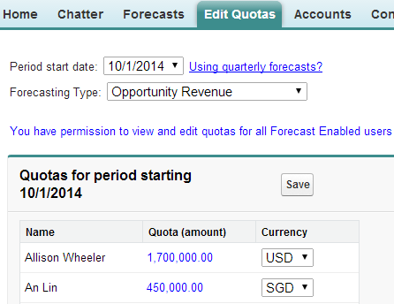
Loading Quota Data
The Edit Quotas app on the Salesforce AppExchange provides a graphical user interface for entering quota data.
Users need the “Manage Quotas” permission to edit quota data.
Adjustments don’t change the individual opportunity amounts that roll up into the forecast. They just add a layer of detail.
NOTE:
CLICK PATH:
Notes:
Teaching Points:
This is a free app created by Salesforce Labs.
When you install the app, it creates a new tab called Edit Quotas.
For each profile, you can control whether or not the Edit Quotas tab is visible.
The Edit Quotas tab allows forecast managers to view and edit the quota data for subordinates. Forecast managers must have the “Manage Quotas” permission to edit quota data.
From the Edit Quotas tab, you can:
Set the monthly or quarterly quota data for sales manager and reps.
Set the revenue and quantity quota data.
Copy the quota data to another time period.

Slide 91
2-9: Add Quota Data for APAC Sales Reps
Watch me:
Goal:
Define revenue quota data for APAC sales reps.
10 minutes
Tasks:
Set the revenue quotas for APAC sales reps for the current and next 3 fiscal quarters.
View the quota data and quota attainment from the forecast.
Name | Current FQ | Current FQ + 1 FQ | Current FQ + 2 FQ | Current FQ + 3 FQ
Fumiko Suzuki | SGD 185K | SGD185K | SGD 125K | SGD 125K
Jin Chang | SGD 185K | SGD185K | SGD125K | SGD125K
Notes:
Teaching Points:
To enter a quarterly forecast, choose the beginning month of the quarter.
Assume the sales organization has a fiscal year that starts in January. This means the beginning of the quarters are: January 1, April 1, July 1, October1.
Answers to questions in the Exercise Guide:
2-F: What is the quota attainment for Fumiko for the Closed forecast category for the current fiscal quarter? dependent on the org data
What is the quota attainment for Jin for the Closed forecast category for the current fiscal quarter? dependent on the org data
Suggestions:
Students can follow along (like a Join Me) if they choose.
This exercise is NOT a dependency for other exercises.
Extra Materials:
As the instructor, you need to perform all of the Your Turn exercises in order to do this Watch Me.

Slide 92
2-10: Add Quota Data for the VP of Global Sales
Your turn:
Goal:
Define revenue quota data for the VP of Global Sales.
5 minutes
Tasks:
Set the revenue quotas for the VP of Global Sales for the current and next 3 fiscal quarters.
View the quota data and quota attainment from the forecast.
Name | Current FQ | Current FQ + 1 FQ | Current FQ + 2 FQ | Current FQ + 3 FQ
Allison Wheeler | USD 1.7M | USD 1.7M | USD 1.3M | USD 1.3M
Notes:
Teaching Points:
To enter a quarterly forecast, choose the beginning month of the quarter.
Assume the sales organization has a fiscal year that starts in January. This means the beginning of the quarters are: January 1, April 1, July 1, October1.
Answers to questions in the Exercise Guide:
2-F: What is the quota attainment for Allison Wheeler for the Closed forecast category for the current fiscal quarter? dependent on the org data

Slide 93
Module Agenda
Enabling Forecasts for Users
Forecasting by Opportunities
Mapping Opportunity Stages to Forecast Categories
Defining Forecast Managers and Enabling Adjustments
Adding Quota Data
Forecasting by Product Family
Forecasting by Opportunity Splits and Custom Fields
Building Reports

Slide 94

Forecasting by Product Families
Forecast Type = Product Families (Revenue)
Forecast Type = Product Families (Quantity)
Opportunity Owner
Matt Wilson
Opportunity Owner
Matt Wilson
Product Family | Total Price
Laptops | $9,275.00
Desktops | $3,500.00
Product Family | Quantity
Laptops | 10
Desktops | 2
Allows organizations who are using Opportunity Products and Product Families to view the forecast separately for each product family.
Notes:
Teaching Points:
When the forecast type is product families revenue, the forecast is based on opportunity owner and total price of all opportunity product lines grouped by product family.
When the forecast type is product families quantity, the forecast is based on opportunity owner and quantity of all opportunity product lines grouped by product family.

Slide 95
2-11: Add a Forecast Type for Product Families (Revenue)
Your turn:
Goal:
Allow users to view the revenue forecast separately for each product family.
5 minutes
Tasks:
Add a forecast type for Product Families (Revenue).
Verify that the forecast displays the revenue forecast for each product family for Kathy Cooper.

Slide 96
Module Agenda
Enabling Forecasts for Users
Forecasting by Opportunities
Mapping Opportunity Stages to Forecast Categories
Defining Forecast Managers and Enabling Adjustments
Adding Quota Data
Forecasting by Product Family
Forecasting by Opportunity Splits and Custom Fields
Building Reports

Slide 97
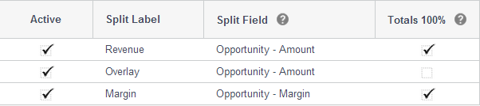
Opportunity Splits
Lets team members share sales credit for an opportunity.
Revenue splits total 100% of the opportunity amount.
Overlay splits total any percentage of the opportunity amount.
Custom splits allow the split to be based on a standard or custom currency field on the opportunity.
Search Help & Training for enabling opportunity splits and split types.
RESOURCE:
Notes:
Teaching Points:
Organizations must be using opportunity teams in order to use opportunity splits.
To view and edit splits, you must be the opportunity owner or above in the organization hierarchy and have access to the split fields.
Use Revenue splits to credit team members who are directly responsible for opportunity revenue.
Use Overlay splits to credit supporting team members. Overlay splits can total percentages over 100%.
If custom split types are enabled for your organization, you can create up to three more split types. To have custom split types enabled for your organization, contact salesforce.com.
As the administrator, you decide whether each custom split type must total 100%.
Split types can be based on most opportunity currency fields, including custom fields and roll-up summary fields, but not formula currency fields.
This example shows a custom split type for the opportunity Margin field.
Suggestions:
In the training org, show students the Opportunity Splits setup menu: Setup | Customize | Opportunities | Opportunity Splits | Settings.

Slide 98
Forecasting by Opportunity Splits
Forecast Type = Opportunity Revenue Splits (Revenue)
Forecast Type = Opportunity Overlay Splits (Revenue)
Opportunity Splits
Opportunity Splits
Team Member | Percent (%) | Amount
Matt Wilson | 75.00 | $6,000.00
Anna Bressan | 25.00 | $2,000.00
Team Member | Percent (%) | Amount
Frank Roberts | 100.00 | $4,000.00
Amy Daniels | 25.00 | $1,000.00
Opportunity Amount = $8,000.00
Opportunity Amount = $4,000.00
Allows organizations who are using Opportunity Splits to reflect the split revenue amounts in the forecast.
Notes:
Teaching Points:
When the forecast type is Opportunity Revenue Splits, the forecast is based on the team member and the Revenue split amount from the Opportunity Splits object.
This lets sales managers track revenue for sales reps who are directly responsible for closing opportunities.
The example shows that two sales reps helped close the opportunity. Matt got credit for 75% of the revenue and Anna got credit for 25% of the revenue.
When the forecast type is Opportunity Overlay Splits, the forecast is based on the team member and the Overlay split amount from the Opportunity Splits object.
This lets sales managers track revenue from sales team members who help close opportunities but are not directly responsible for them. By tracking this kind of revenue, sales managers can see the contributions of their overlay sales teams.
The example shows that the Frank Roberts, a sales rep, got 100% credit for the opportunity. But Amy Daniels, a sales engineer, also got 25% credit for the opportunity.
When forecasting by opportunity splits, you can only forecast by revenue. You cannot forecast by quantity.

Slide 99

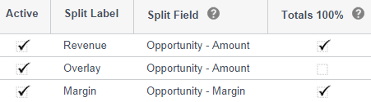
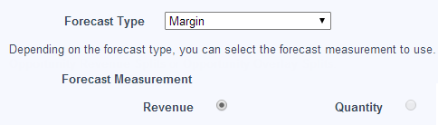
Forecasting by Custom Fields
Allows organizations to forecast on custom opportunity currency fields.
Create a custom opportunity currency field.
Enable opportunity splits and add a custom split type for the custom field.
Add a forecast type for the custom split type.
99
Notes:
Teaching Points:
Collaborative Forecasts lets your sales team forecast on custom opportunity currency fields. To forecast by custom fields, you must:
Create a custom opportunity currency field. This example shows a custom field called Margin, but you might want to create custom fields for Monthly Recurring Revenue, Annual Contract Value, or any other currency field that your organization requires.
Enable opportunity splits and add a custom split type for the custom field. You must do this step even if you are not using opportunity splits in your organization.
Add a forecast type for the custom split type.
When forecasting by custom fields, you can only forecast by revenue. You cannot forecast by quantity.
If you do not use opportunity splits on your custom fields, the opportunity owner automatically receives a 100% split for the field. Your custom field forecast is the same as if there were no splits.
If you use opportunity splits on your custom fields, your custom field forecasts include the splits.
If the forecast manager or sales rep viewing the forecast does not have access to the custom opportunity field, they can see forecast amounts but they won’t be able to see any of the custom field values in the opportunity list

Slide 100
2-12: Add a Forecast Type for Margin
Your turn:
Goal:
Allow users to view the forecast based on a custom field.
5 minutes
Tasks:
Add a forecast type for Margin.
View the margin forecast for Fumiko Suzuki, an APAC Sales Rep.

Slide 101
Module Agenda
Enabling Forecasts for Users
Forecasting by Opportunities
Mapping Opportunity Stages to Forecast Categories
Defining Forecast Managers and Enabling Adjustments
Adding Quota Data
Forecasting by Product Family
Forecasting by Opportunity Splits and Custom Fields
Building Reports

Slide 102
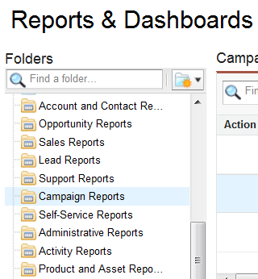
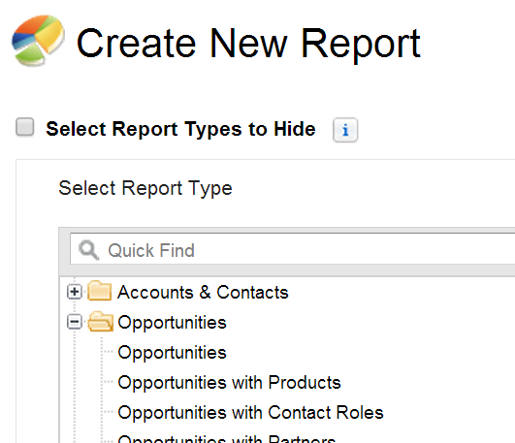
Creating Reports for Collaborative Forecasts
Standard report folders
Standard report types used to create custom reports
There are no standard reports or standard report types for Collaborative Forecasts. You must create a custom report type to make collaborative forecast reports available to users.
Notes:
Teaching Points:
Using a custom report type gives users the flexibility to build the reports that they want to see.

Slide 103
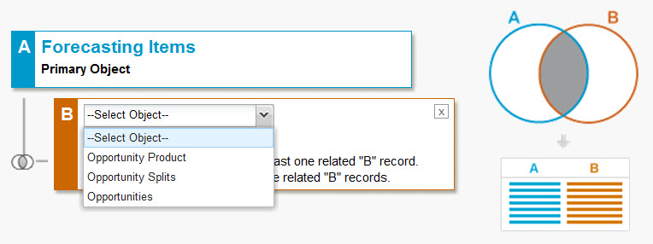
Creating a Custom Report Type for Forecasting Items
You can create a custom report type for Forecasting Items and include related Opportunity Products, Opportunity Splits, or Opportunities.
Notes:
Teaching Points:
The Forecasting Items object contains all the forecasting fields.
When using Forecasting Items as the primary object, you can include related Opportunity Products, Opportunity Splits, or Opportunities.
Suggestions:
Ask students how many of them have ever created a custom report type before. If this is new for most students, explain these key concepts about custom report types:
Custom report types let you create your own report frameworks from which new custom reports can be built.
The primary object determines which related objects can be included in the report type.
The primary object determines which object appears in the Show filter in the report builder.
You can associate up to four objects to a custom report type.
You can define which related records from other objects are returned in report results by choosing a relationship to another object.
Each "A" record must have at least one related "B" record—only parent records with child records are shown in the report.
"A" records may or may not have related "B" records—parent records are shown, whether or not they have child records.

Slide 104




Understanding Forecasting Amounts on Reports
There are several forecasting amount fields that can be used on a report.
Forecast for Kathy Cooper
Sales User | Commit Forecast | Kathy’s Adjustment
 | $1M | $1M
 | $1M | $1.05M
 | $1M | $1.05M
My Opportunities | $0
Total | $3M | $3.1M
Forecast Amount
Total opportunity amount for Kathy and her subordinates, including all adjustments.
Owner Only Amount
Total opportunity amount for only Kathy.
$3.3M
Allison’s Adjustment
Amount Without Adjustments
Total opportunity amount for Kathy and her subordinates.
Amount Without Manager Adjustments
Total opportunity amount for Kathy plus adjusted amount of her subordinates.
Notes:
Teaching Points:
The sales organization uses adjustments to ensure the forecast is accurate. Allison Wheeler, VP of Global Sales, reviews the forecasting amounts for Kathy Cooper for the Commit forecast category for the current FQ.
Kathy’s Owner Only Amount is the total amount of her own opportunities. At AW Computing, managers do not own opportunities. Only sales reps own opportunities. Kathy’s Owner Only Amount = $0
Kathy’s Amount Without Adjustment total amount of opportunities owned by her subordinates. This amount is the roll-up of actual opportunity amounts. It does not include any adjustments.
Kathy’s Amount Without Adjustments = $3.0M
Kathy adjusted the forecast of some of her reps (these are the amounts in red) because she knows that they will outperform their forecast. Kathy’s Amount Without Manager Adjustments is the total opportunity amount of her own opportunities plus the adjusted amount of her subordinates. This amount does not include adjustments by managers above Kathy in the forecast hierarchy.
Kathy’s Amount Without Manager Adjustments = $3.1M
Allison adjusted the forecast for Kathy to $3.3M, because she knows that Kathy and her team always outdo themselves. Kathy’s Forecast Amount is the total opportunity amount for Kathy and her subordinates, including all forecast adjustments. Kathy’s Forecast Amount = $3.3M
Ask the students the following questions: 1. What is the dollar amount of adjustments made by Kathy to her subordinates’ forecasts?
Answer: $100,000 (Amount Without Manager Adjustments – Amount Without Adjustments)
2. Allison Wheeler wants to analyze the adjusted forecast by category for this quarter and the next three quarters for the entire sales organization. Which forecast field should you use in the report?
Answer: Forecast Amount

Slide 105
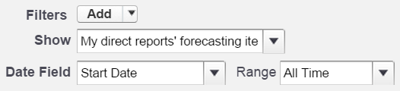
Filtering Forecast Data
Since forecast data rolls up through the forecast hierarchy, you must filter the report to only show the data for direct reports.
Notes:
Teaching Points:
If you do not filter the data by owner, you will double count the forecast amount.
The “My direct reports’ forecasting items” filter allows any forecast manager to see the forecast data for his or her direct reports. The report data will change depending on which forecast manager is viewing the report.
Alternatively, you can add a filter to only show the forecast data for specific users. Make sure that the specific users in the filter do not roll up to each other.

Slide 106
2-13: Build a Forecast Amount Report
Your turn:
Goal:
Build a report to show the adjusted forecast.
10 minutes
Objects
Forecasting Items (custom report type)
Scope
My direct reports’ forecasting items
Columns
Format
Matrix
Forecast Amount, Forecast Category, Start Date
Groupings
Row grouping–Start Date grouped by Fiscal Quarter
Summaries
Filters
Forecasting Type: API Name equals OpportunityRevenue
Charts
Vertical bar chart that displays the Forecast Amount by Start Date, stacked by Forecast Category
Sum of Forecast Amount
Start Date–Current and Next 3 FQ
Column grouping–Forecast Category
Notes:
Teaching Points:
The Forecasting Items custom report type has already been created for you.
You will use Forecast Amount in the report, because this value shows the adjusted forecast amount.
When you add the filter, make sure you enter OpportunityRevenue (no spaces) as the Forecasting Type: API Name value.

Slide 107
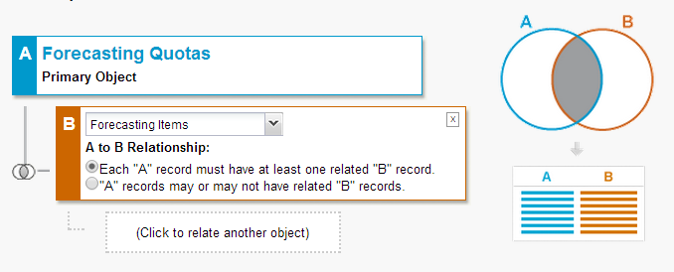
Creating a Custom Report Type for Forecasting Quotas
You can create a custom report type for Forecasting Quotas and include related Forecasting Items.
Notes:
Teaching Points:
The Forecasting Quotas object contains all the quota fields.
When using Forecasting Quotas as the primary object, you can include related Forecasting Items. This allows you to use both forecasting and quota fields in the report.

Slide 108
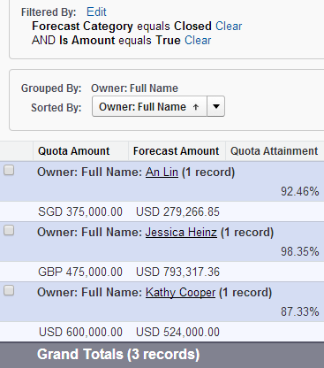
Calculating Quota Attainment
Create a custom report using a Forecasting Quotas with or without Forecasting Items custom report type.
Display the revenue quota data for the Closed forecast category.
Custom summary formula:
Forecast Amount / Quota Amount
Notes:
Teaching Points:
Include the quota amount and forecast amount in the report.
Filter the data to only include the forecast amount from the Closed forecast category.
Filter the data to only display the revenue quota data.
Create a custom summary formula to calculate the quota attainment, which is the closed forecast amount divided by the quota amount.

Slide 109
Knowledge Check
What are the capabilities of Collaborative Forecasts?
What types of forecast data can a sales user view from the Forecasts tab?
Jessica Heinz is a forecast manager with the “Override Forecasts” permission. What does this allow her to do?
How can an administrator configure forecast categories?
When creating a forecasting report, what field displays the roll up of actual opportunity amounts for a manager and his or her subordinates?
Notes:
Teaching Points
Use the Knowledge Check Manager in place of this slide. 1. When using Collaborative Forecasts, the Forecasts tab displays revenue and quantity forecasts, quotas and attainment percentages, monthly or quarterly forecasts, and the opportunities that make up the forecast. Organizations using Communities can include partner-owned opportunities in forecasts. In addition, forecast managers can adjust the forecast of direct subordinates and forecast users can adjust the forecast amount of their own forecast to increase the accuracy of forecasts. 2. An administrator can enable up to four different types of forecasts. This allows sales users to view the expected revenue or quantity from opportunities, expected revenue or quantity for each product family, the expected revenue including the Revenue split amount, the expected revenue including the Overlay split amount, or the expected revenue from custom opportunity currency fields. 3. Forecast managers with the “Override Forecasts” permission can view the forecast for all users below them in the forecast hierarchy and adjust the forecast of users directly below them in the forecast hierarchy. 4. Forecast categories group opportunities together based on opportunity stage. An administrator defines which opportunity stages map to each forecast category. An administrator can also change the forecast category names. In addition, an administrator can choose to display individual forecast categories or cumulative forecast rollups for the organization.
5. Amount Without Adjustments displays the rollup of actual opportunity amounts for a manager and his or her subordinates. It does not include any adjustments.

Slide 110

What’s Next
Thank you for attending!
Your satisfaction is very important to us. Click on the Course Survey link located on the Home Page of your training org to give us your feedback.
Get certified! Go to www.webassessor.com/salesforce to register.
Take the next step! Register for the next course! Go to www.salesforce.com/training.

Slide 111


Salesforce University
Training and Certification Resources
Training Webpage: www.salesforce.com/training
Certification Webpage: certification.salesforce.com
Follow us on Twitter: @SalesforceU
Salesforce Success Community:
Log in to Salesforce → Help & Training → Collaboration
© Copyright 2017 salesforce.com, inc. All rights reserved. Various trademarks held by their respective owners.

